Slide 1

Weather analysis in Australia
Revision in rain and climate base of Tidytuesday site

Slide 2

List
1- Start traveling with datasets
Introducing climate datasets
2- Painting with numbers
Colouring and story telling with simple charts
3- Hidden secrets in columns
Recognizing trends with complicated charts
4- Conclusion
Generalization dataset stories under each charts

Slide 3

Introducing quality of weather and climate datasets
Even climate wants to speak with us!
Drops of water, Temperature and even bacteria inside of them have lots of information!
In middle of it, even geographical places, days and time are considered!
Our aim is to recognize relationships, to see what will happen after rainy day in Australia or see and recognize the bacteria inside it!

Slide 4

How can we enter to climate datasets for analysisin R:
library(dplyr)
library(tidytuesdayR)
tt <- tidytuesdayR::tt_load('2025-05-20')
Our datasets have 2 categories which is relating to Australia. One category contains information about place of swimming, region, latitude, longitude, day, hour, amount of bacteria, conductivity. The other category contains day, max and min temperature, latitude, longitude and cementation.

Slide 5
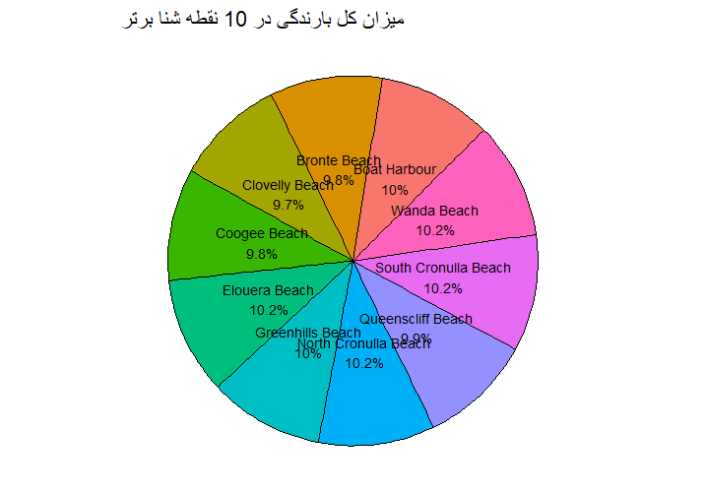
Now, we want to see which places had rain the most?
ggplot(rain_top10, aes(x = reorder(swim_site, total_precipitation), y = total_precipitation, fill = swim_site)) + geom_col(show.legend = FALSE) + coord_flip() + labs(title = "میزان کل بارندگی در 10 نقطه شنا برتر", x = "نقطه شنا", y = "کل بارندگی (میلی‌متر)") + theme_minimal()

Slide 6
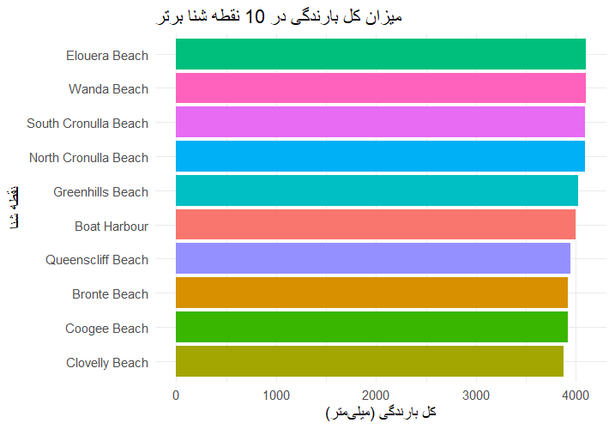
We now want to analysis with bar charts. To see which swimming places had more mean of rain.
ggplot(rain_top10, aes(x = reorder(swim_site, total_precipitation), y = total_precipitation, fill = swim_site)) + geom_col(show.legend = FALSE) + coord_flip() + labs(title = "میزان کل بارندگی در 10 نقطه شنا برتر", x = "نقطه شنا", y = "کل بارندگی (میلی‌متر)") + theme_minimal()

Slide 7
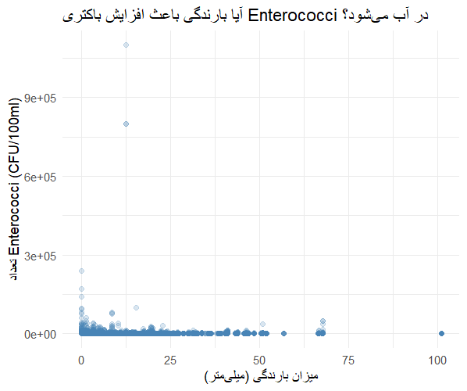
Now we want to see if increasing rain increasing enterococci bacteria?
ggplot(combined, aes(x = precipitation_mm, y = enterococci_cfu_100ml)) + geom_point(alpha = 0.2, color = "steelblue") + labs( title = "آیا بارندگی باعث افزایش باکتری Enterococci در آب می‌شود؟", x = "میزان بارندگی (میلی‌متر)", y = "تعداد Enterococci (CFU/100ml)" ) + theme_minimal()
According the charts when rain increase enterococci bacteria will decrease.
But statistical test is more accurate. Thus we calculate that too.
precipitation_mm = 21.225
The coefficient is positive. So we have positive relationship.

Slide 8
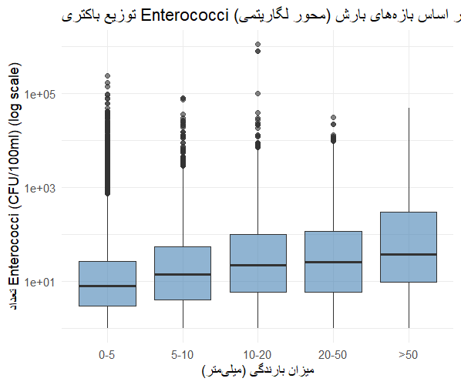
Look at charts. One reason that in last slide why the conclusion from charts and test is different is because of outliers. Base of following chart, outliers are more when amount of rain is lower. So that in real and without outliers the result is as same as test. The more rain is the more bacteria will be.

Slide 9
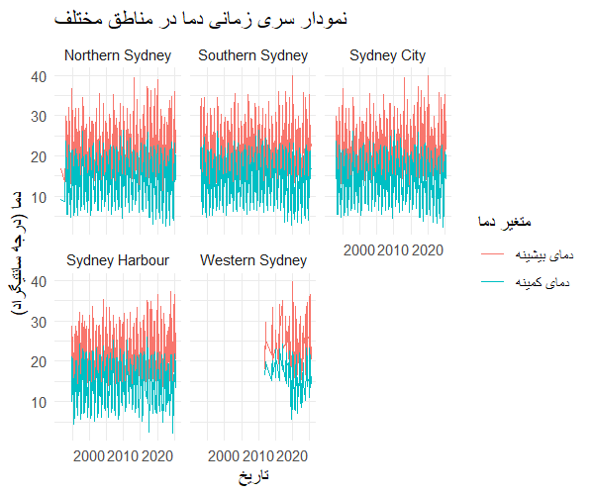
Max and min of temperature for some regions.
ggplot(temp_summary, aes(x = date)) + geom_line(aes(y = max_temp, color = "دمای بیشینه")) + geom_line(aes(y = min_temp, color = "دمای کمینه")) + facet_wrap(~region) + labs(title = "نمودار سری زمانی دما در مناطق مختلف", x = "تاریخ", y = "دما (درجه سانتیگراد)", color = "متغیر دما") + theme_minimal()

Slide 10
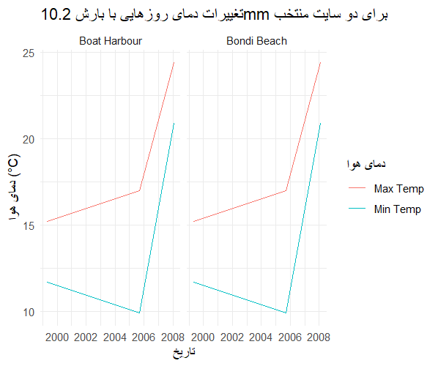
2 places have rain amount of 10.2 and we want to assess their temperature. (and see if there is relationships between temperature and rain).
ggplot(temp_summary, aes(x = date)) + geom_line(aes(y = max_temp, color = "دمای بیشینه")) + geom_line(aes(y = min_temp, color = "دمای کمینه")) + facet_wrap(~region) + labs(title = "نمودار سری زمانی دما در مناطق مختلف", x = "تاریخ", y = "دما (درجه سانتیگراد)", color = "متغیر دما") + theme_minimal()

Slide 11
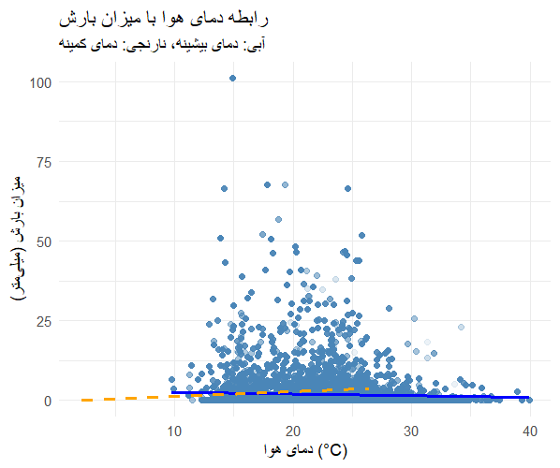
According to chart, the more temperature we have the less rain we have!

Slide 12
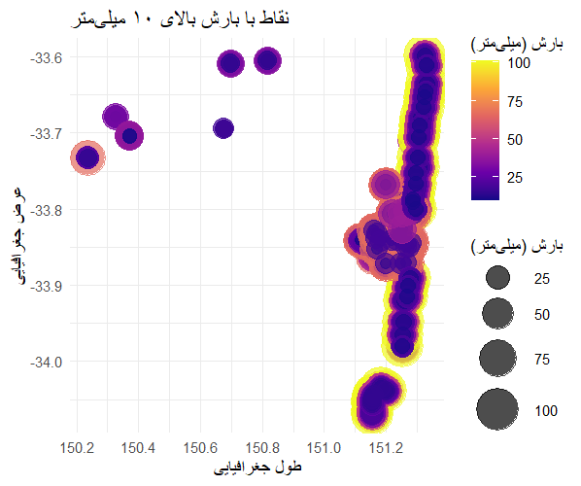
The places based of latitude and amount of rain

Slide 13
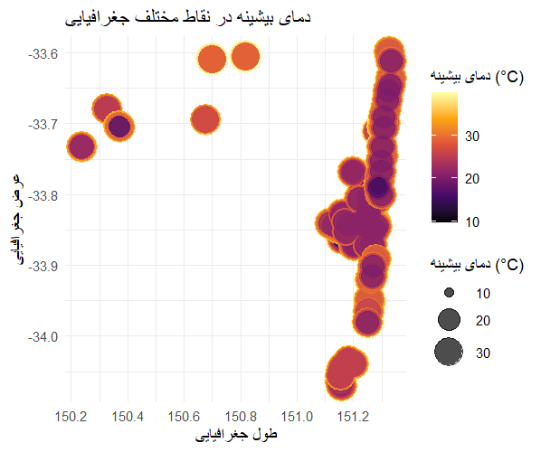
The places based of latitude and temperature

